Slide 1
Aggregate functions

Slide 2
Introduction to PostgreSQL aggregate functions
Aggregate functions perform a calculation on a set of rows and return a single row. PostgreSQL provides all standard SQL’s aggregate functions as follows:
AVG() – return the average value.
COUNT() – return the number of values. MAX() – return the maximum value.
MIN() – return the minimum value.
SUM() – return the sum of all or distinct values.
We often use the aggregate functions with the GROUP BY clause in the SELECT statement. In these cases, the GROUP BY clause divides the result set into groups of rows and the aggregate functions perform a calculation on each group e.g., maximum, minimum, average, etc.
You can use aggregate functions as expressions only in the following clauses: SELECT clause.
HAVING clause.

Slide 3
PostgreSQL AVG Function
The AVG() function is one of the most commonly used aggregate functions in PostgreSQL. The AVG() function allows you to calculate the average value of a set.
The syntax of the AVG() function is as follows: AVG(column)
You can use the AVG() function in the SELECT and HAVING clauses.

Slide 4
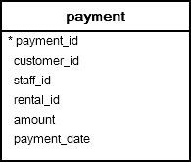
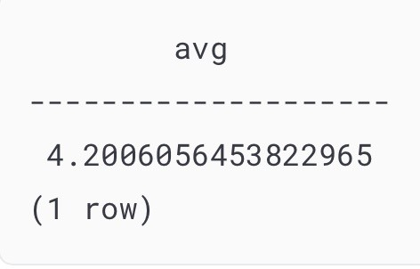
Example
SELECT AVG(amount) FROM payment;

Slide 5
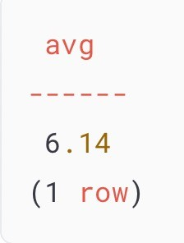
PostgreSQL AVG() function with DISTINCT operator
SELECT AVG(DISTINCT amount)::numeric(10,2) FROM payment;

Slide 6
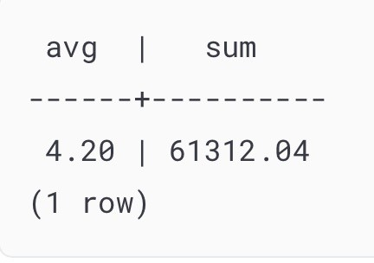
PostgreSQL AVG function with SUM function
SELECT
AVG(amount)::numeric(10,2), SUM(amount)::numeric(10,2)
FROM
payment;

Slide 7
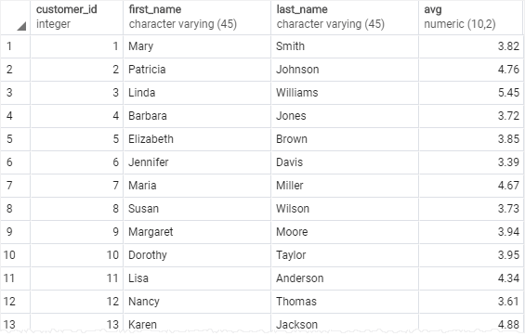
PostgreSQL AVG() function with GROUP BY clause
SELECT
customer_id,
first_name, last_name,
AVG (amount)::NUMERIC(10,2)
FROM
payment
INNER JOIN customer USING(customer_id) GROUP BY
customer_id ORDER BY
customer_id;

Slide 8
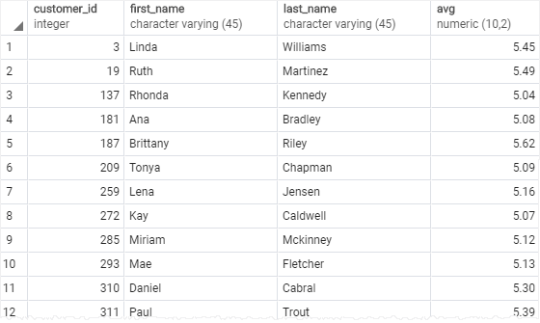
PostgreSQL AVG() function with HAVING clause
SELECT
customer_id, first_name, last_name,
AVG (amount)::NUMERIC(10,2)
FROM
payment
INNER JOIN customer USING(customer_id) GROUP BY
customer_id
HAVING
AVG (amount) > 5 ORDER BY
customer_id;

Slide 9
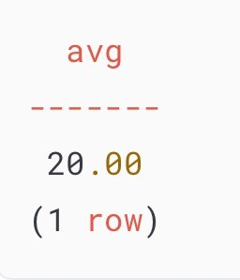
PostgreSQL AVG() function and NULL
CREATE TABLE t1 (
id serial PRIMARY KEY, amount INTEGER
);
SELECT AVG(amount)::numeric(10,2) FROM t1;
INSERT INTO t1 (amount) VALUES
(10),
(NULL),
(30);

Slide 10
PostgreSQL COUNT Function
The COUNT() function is an aggregate function that allows you to get the number of rows that match a specific condition of a query.
SELECT COUNT(column)
FROM table_name WHERE condition;

Slide 11
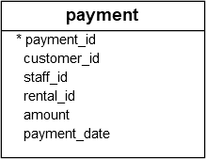

PostgreSQL COUNT() function examples
SELECT COUNT(*)
FROM
payment;

Slide 12
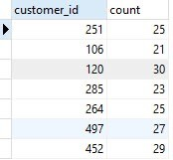
PostgreSQL COUNT() with GROUP BY clause
SELECT
customer_id,
COUNT (customer_id) FROM
payment GROUP BY
customer_id;

Slide 13

PostgreSQL COUNT() with HAVING clause
SELECT
customer_id,
COUNT (customer_id) FROM
payment GROUP BY
customer_id HAVING
COUNT (customer_id) > 40;

Slide 14
PostgreSQL SUM Function
The PostgreSQL SUM() is an aggregate function that returns the sum of values or distinct values.
The syntax of the SUM() function is as follows: SUM(DISTINCT expression)

Slide 15
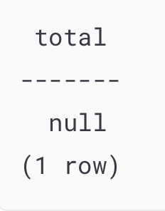
PostgreSQL SUM() function examples
SELECT SUM (amount) AS total FROM payment
WHERE customer_id = 2000;

Slide 16
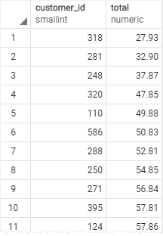
Using PostgreSQL SUM() function with GROUP BY clause
SELECT
customer_id,
SUM (amount) AS total FROM
payment GROUP BY
customer_id ORDER BY total;

Slide 17
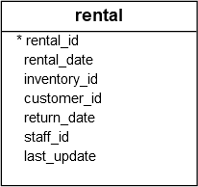
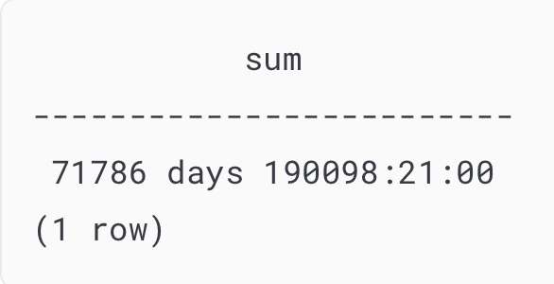
Using PostgreSQL SUM with expression
SELECT SUM(return_date - rental_date ) FROM rental;

Slide 18
PostgreSQL MAX Function
PostgreSQL MAX function is an aggregate function that returns the maximum value in a set of values.
The syntax of the MAX function is as follows: MAX(expression);
You can use the MAX function not only in the SELECT clause but also in the WHERE and HAVING clauses.

Slide 19

PostgreSQL MAX function examples
SELECT MAX(amount) FROM payment;

Slide 20
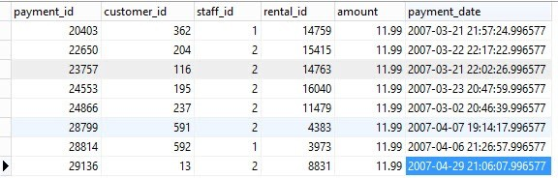
PostgreSQL MAX function in subquery
SELECT * FROM payment WHERE amount = (
SELECT MAX (amount) FROM payment
);

Slide 21
PostgreSQL MIN Function
PostgreSQL MIN() function an aggregate function that returns the minimum value in a set of values.
The syntax of the MIN() function is as follows:
SELECT
MIN(expression) FROM
table_expression
...;
Unlike the AVG(), COUNT() and SUM() functions, the DISTINCT option does not have any effects on the MIN() function.

Slide 22
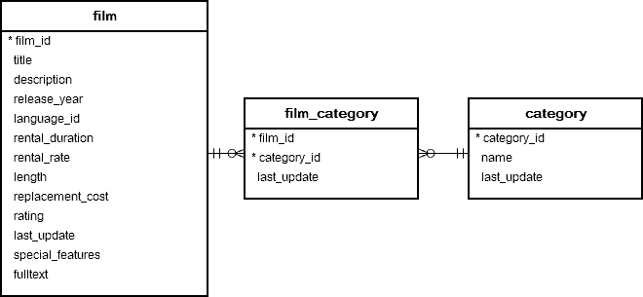

PostgreSQL MIN() function examples
SELECT
MIN (rental_rate) FROM
film;

Slide 23
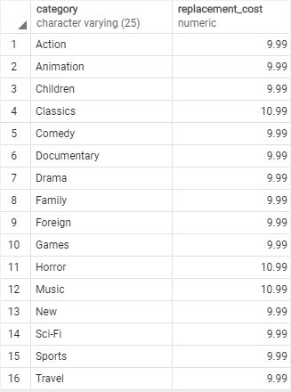
Using PostgreSQL MIN function with GROUP BY clause
SELECT
name category,
MIN(replacement_cost) replacement_cost FROM category
INNER JOIN film_category USING (category_id) INNER JOIN film USING (film_id)
GROUP BY name ORDER BY name;

